Slide 1
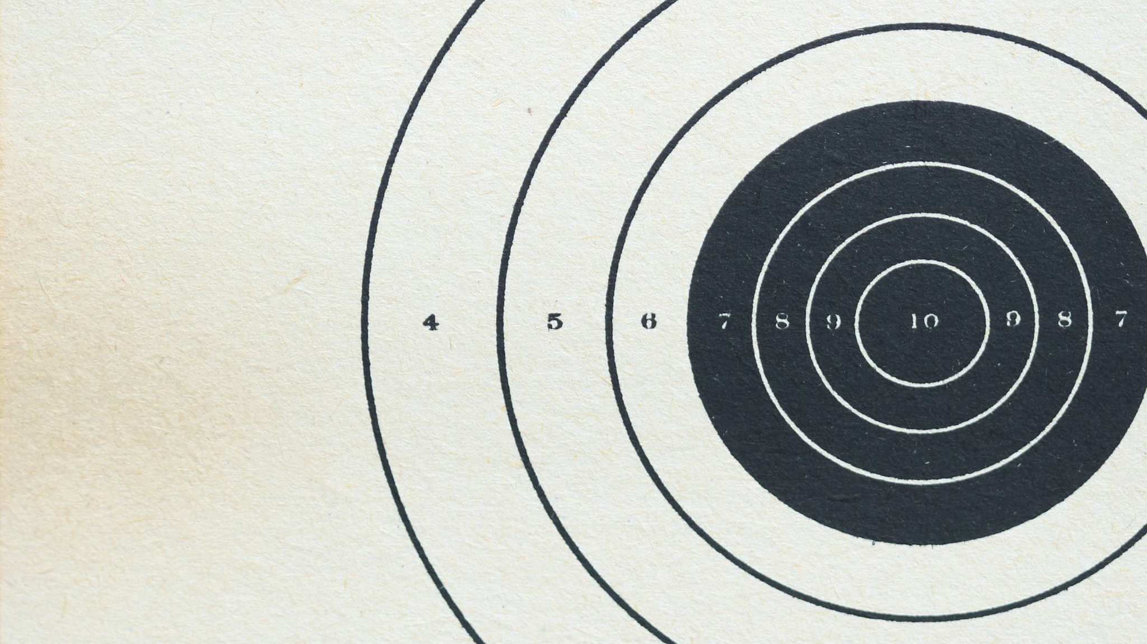
RANSAC for Detecting Circle
Student: Cristian Casian-Cristi
Group: 30422

Slide 2
Introduction
The project aims to detect circles in an image using a combination of Canny Edge Detection and the RANSAC algorithm implemented in OpenCV with C++.

Slide 3
Key Terms
Canny Edge Detection: A multi-step algorithm to detect edges in an image by finding areas of rapid intensity change.
RANSAC (Random Sample Consensus): An iterative algorithm to estimate parameters of a mathematical model (e.g., a circle) by excluding outliers.

Slide 4
Related work
IP LAB 11 – Canny Edge Detection
PRS LAB 2 – RANSAC Algorithm
https://math.stackexchange.com/questions/213658/get-the-equation-of-a-circle-when-given-3-points - formulas used for finding circle
https://computervision-projects.firebaseapp.com/assignment2 - RANSAC Algorithm for detecting circle
https://sdg002.github.io/ransac-circle/index.html - RANSAC Algorithm for detecting circle

Slide 5
Proposed Method
This solution involves two key components:
Canny Edge Detection: For detecting edges in an image using gradient magnitudes and non-maximum suppression.
RANSAC-Based Circle Detection: For identifying circular features in edge-detected images.

Slide 6
Canny Edge Detection
Compute gradients using Sobel filters.
Calculate gradient magnitude and angle.
Perform non-maximum suppression to thin edges.
Classify edges: strong, weak and non-edges.
Extend strong edges by recursively marking connected weak edges as strong.

Slide 7
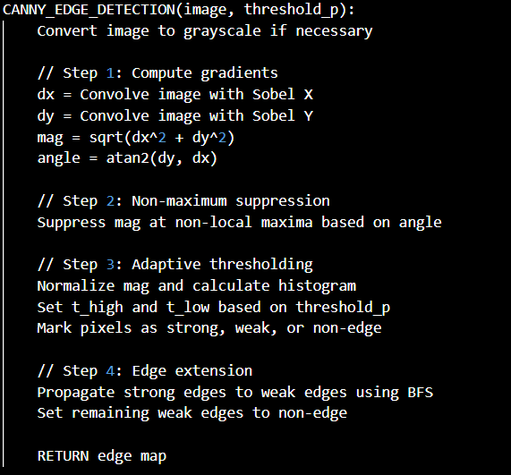
Canny Edge Detection - Pseudocode

Slide 8
RANSAC
Randomly sample three edge points to hypothesize a circle.
Compute the circle's center and radius using determinant-based formulas.
Count inliers: Points close to the hypothesized circle (distance threshold t).
Update the best-fit circle if inliers exceed previous maximum.
Terminate after a sufficient number of trials (N).

Slide 9
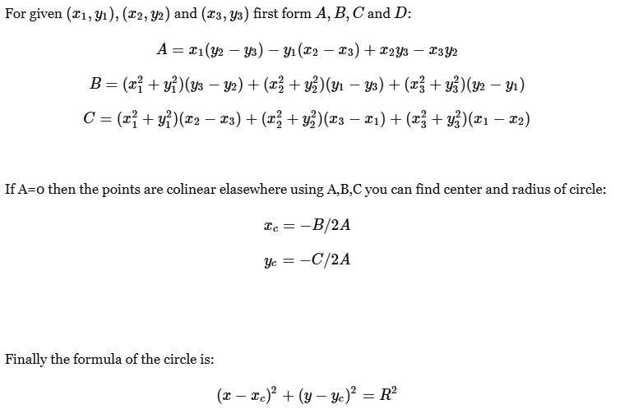
RANSAC – Formulas used

Slide 10
RANSAC - Pseudocode
RANSAC_CIRCLE_DETECTION
Extract edge points from edges image into a list v
n = Number of edge points
q = Inlier ratio (estimated probability a point is an inlier)
T = Minimum inlier count to consider a valid circle
s = Number of points required to estimate a circle (3 for circle)
N = Number of iterations = log(1 - confidence_p) / log(1 - q^s)
Initialize maxInliers = 0, best_center = None, best_radius = None
FOR trial = 1 to N:
Randomly select 3 unique points from v: p1, p2, p3
Compute circle parameters (center and radius) from p1, p2, p3
IF points are collinear:
Skip this iteration
Initialize inliers = 0
FOR each point in v:
Compute distance from point to circle
IF distance is within inlier_threshold_t of radius:
Increment inliers
IF inliers > maxInliers:
Update maxInliers, best_center, and best_radius
RETURN best_center, best_radius, and maxInliers

Slide 11
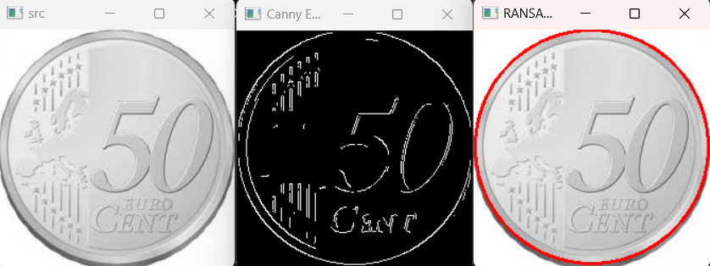
Experimental results

Slide 12
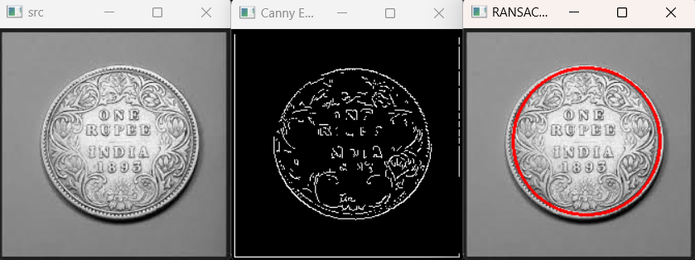
Experimental results

Slide 13
What works?
Edge Detection successfully identifies edges in grayscale images
The RANSAC algorithm is applied effectively for detecting circular shapes in edge-detected images

Slide 14
What does not work?
Accuracy of detected circles: this suggests the RANSAC algorithm might miss optimal solutions due to suboptimal random samping or low number of trials
Noise and incomplete edges: Incomplete or fragmented edges due to Canny's thresholds can hinder accurate circle fitting.

Slide 15
THANK YOU!

